Slide 1
Getting started with R

Slide 2
Install R on your computer, assuming it’s a PC
Goto: https://cran.r-project.org/
Press: Download R for Windows
Press: install R for the first time.
Press: Download R 3.4.2 for Windows
Run: R-3.4.2-win.exe
Select all the defaults during install

Slide 3
Suggest you also install RStudio
Go to: https://www.rstudio.com/
Under Rstudio press: Download
Under the FREE Desktop version press:
Press: RStudio 1.0.153 - Windows Vista/7/8/10
After download run: RStudio-1.0.153.exe
Select all the defaults during install
DOWNLOAD

Slide 4
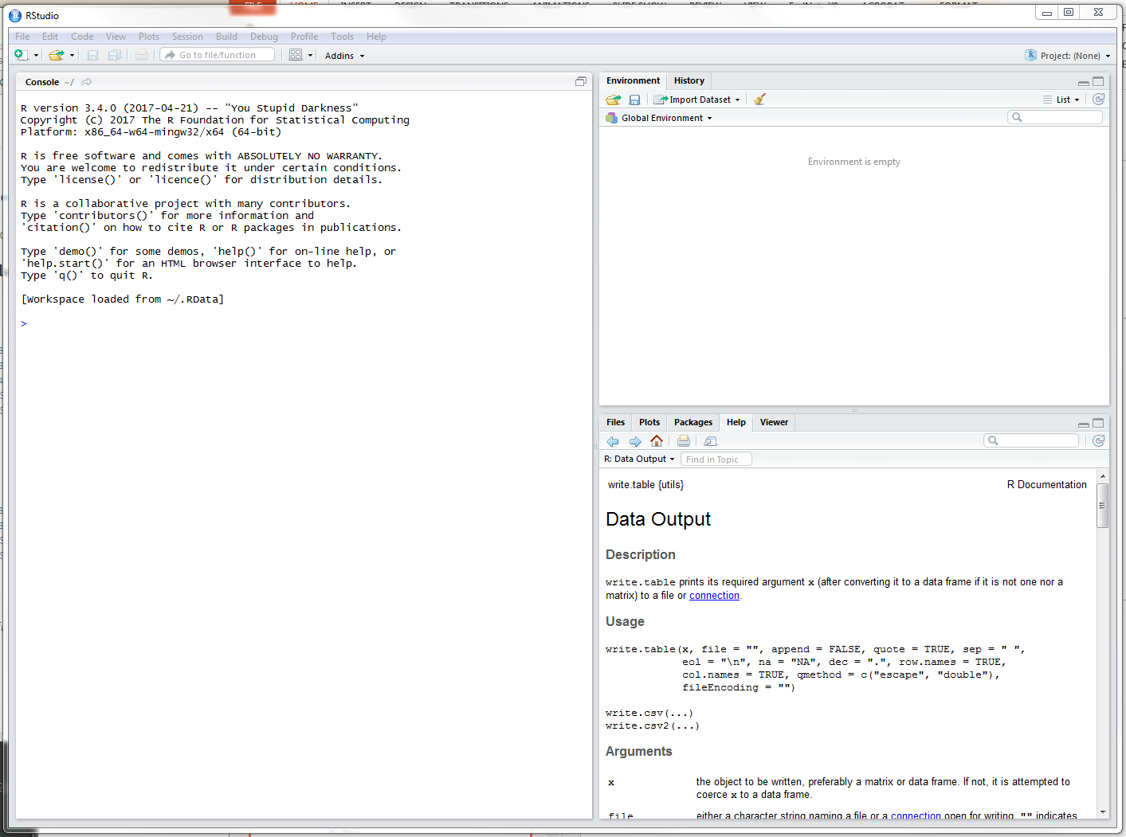
Start RStudio, it will look something like this:

Slide 5
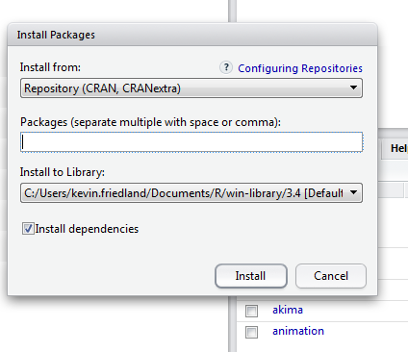
In the lower right box, press on the Packages tab.
Then press the Install tab at the upper right, you will see this dialog box

Slide 6
In the packages line, type the name of the package/library you want to add to R, when you hit install it will retrieve the package (assuming the PC is connected to the web) and install it.
So to install ncdf4, you type that and when you want to use it in a program you use the require(ncdf4) command.
Below are the required libraries for the remote sensing exercise.
require(ncdf4)
require(raster)
require(maps)
require(marmap)
require(chron)
require(maptools)
require(Kendall)

Slide 7
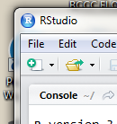
When done with packages, go to the upper left
Press the green + sign and take the first choice a R Script
A fourth pane will open in the upper right. This is a text editor to start to write R program/function/scripts/etc.
Type or copy:
# the hash symbol tells R everything after it on line is a comment and not code
greeting = "Hello world" # create an object called greeting
print(greeting) # print the object
# the output appears in the box below
# > print(greeting)
# [1] "Hello world"

Slide 8
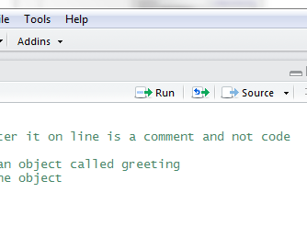
Run the lines in the script by highlighting the lines your want to run
Then press the Run button at the top of the pane:

